Slide 1
Learning Objective
To verify that you are enrolled in the correct ACC Spring Courses
Agenda:
Announcements
Presentation

Slide 2
Announcements
Theme Fridays we will have a new theme that you can dress up either onsite or online and take a pic.
Send all pics to Areal Fischer (958601@student.bisdtx.org) and Mr. Gordon (jgordon@bisdtx.org).
Dec. 4th Associate of Science Pre-Med Informational Meeting 3:15 PM
Dec. 11th Ugly Sweater Day
Dec. 11th Picture Retakes and Pictures for Online Students
Dec. 11th Last Day of ACC Fall Semester
Dec. 11th UNT Admissions Representative 10 AM
January Junior Jumpstart
College Board College Scholarship

Slide 3
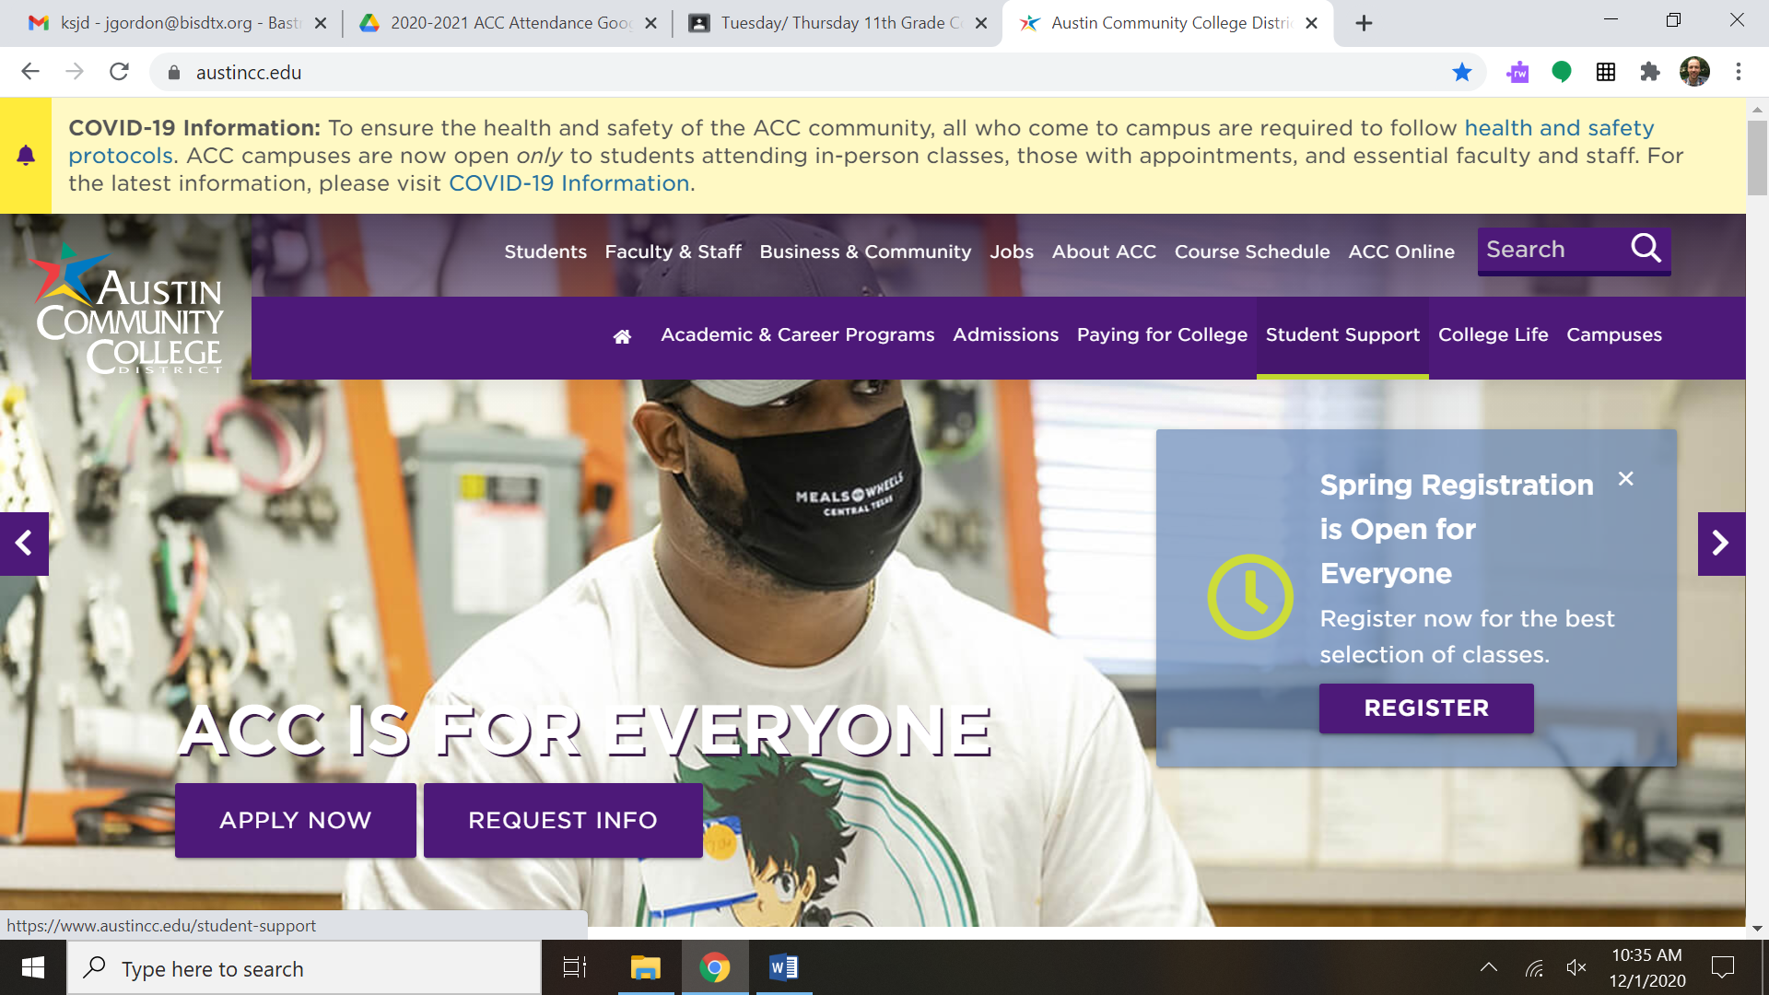
How to Check ACC Spring Semester Classes
Step 1: Go to austincc.edu and click “Students” in the top left corner

Slide 4
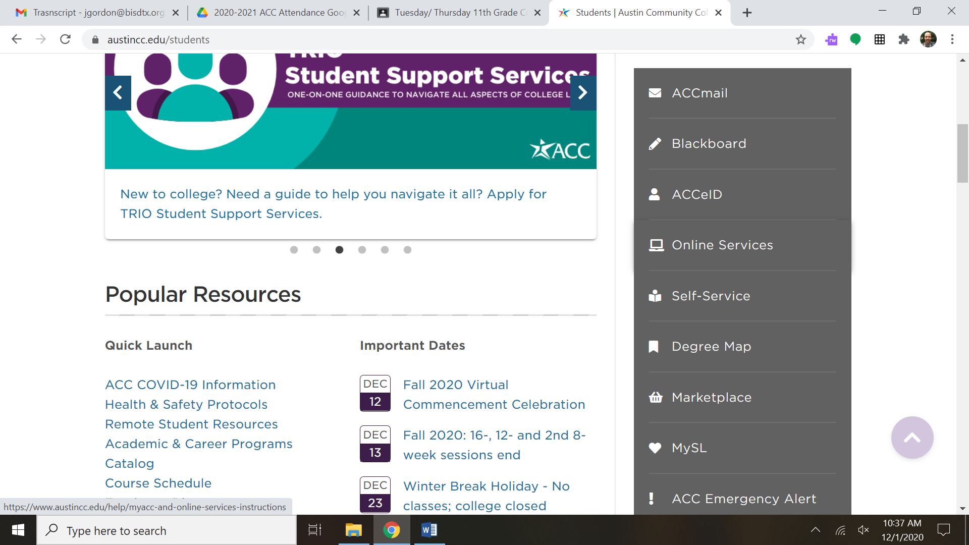
How to Check ACC Spring Semester Classes
Step 2: Scroll down and click “Self-Service” in the middle right.

Slide 5
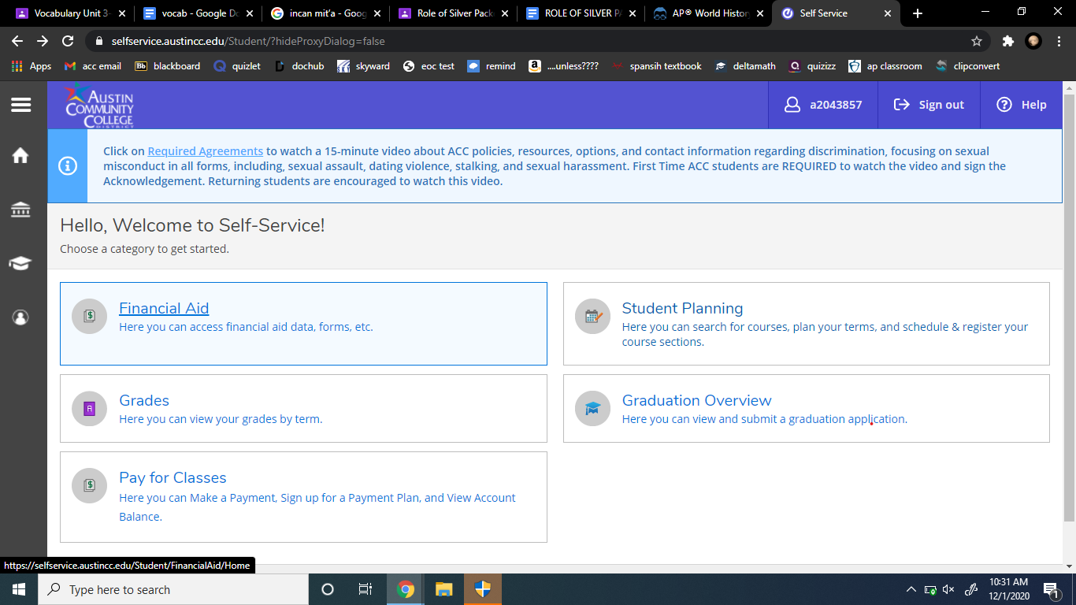
How to Check ACC Spring Semester Classes
Step 3: Login to My ACC and click on “Student Planning”

Slide 6
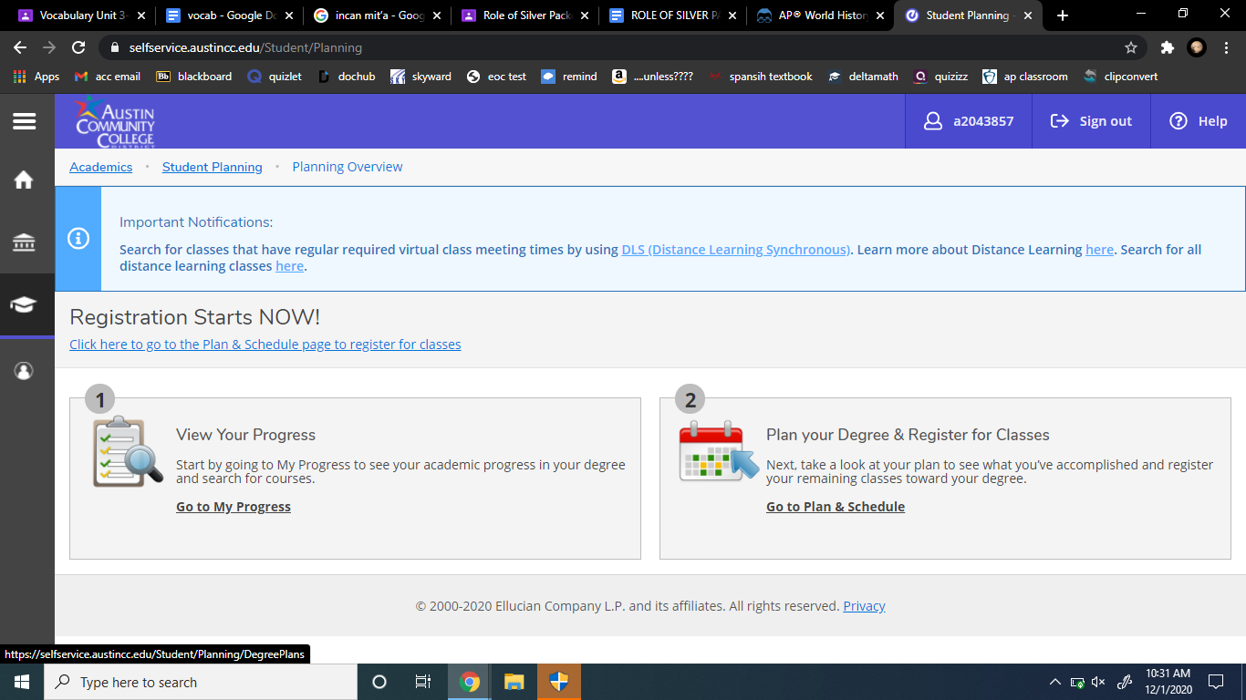
How to Check ACC Spring Semester Classes
Step 4: Click on “Go to Plan & Schedule” under Plan your Degree & Register for Classes

Slide 7
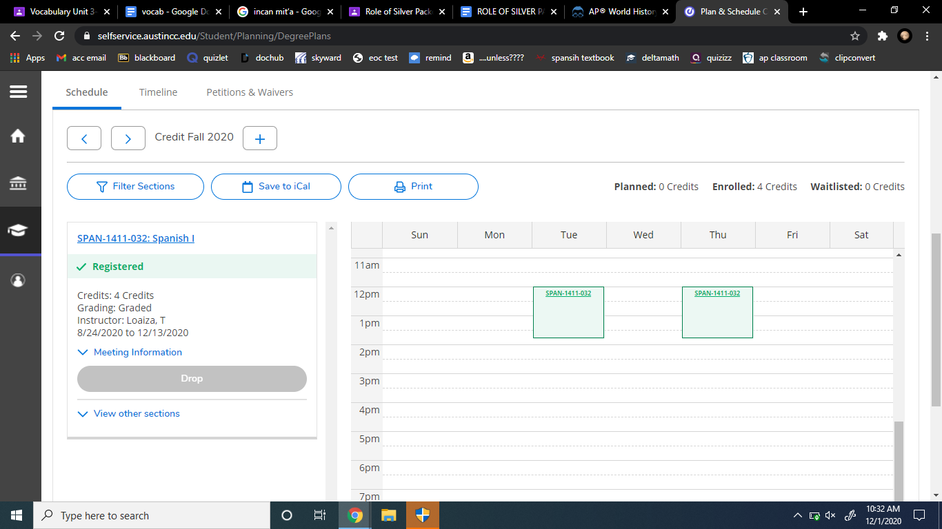

How to Check ACC Spring Semester Classes
Step 5: Scroll down and you will see the schedule. You will need to click the right arrow to change it from Fall 2020 to Spring 2021.

Slide 8
How to Check ACC Spring Semester Classes
If something is incorrect, please email Mr. Longoria and Mr. Gordon ASAP.
Sophomores should have 2 classes, Juniors should have 3, and Seniors should have 4 (unless otherwise discussed with Mr. Longoria).

